Slide 1
Assignment Problems / Housing Allocation Problem
INFO 4220 – Networks II: Market Design
Adapted from Haeringer Ch.11

Slide 2
Introduction
We have been considering problems where we match individuals (or agents) to other individuals (or agents)
Both sides in the matching have preferences over each other
What if instead of matching two sides of agents, we want to match agents to objects
Agents have preferences over objects, but objects don’t have preferences
These problems are called “assignment problems”

Slide 3
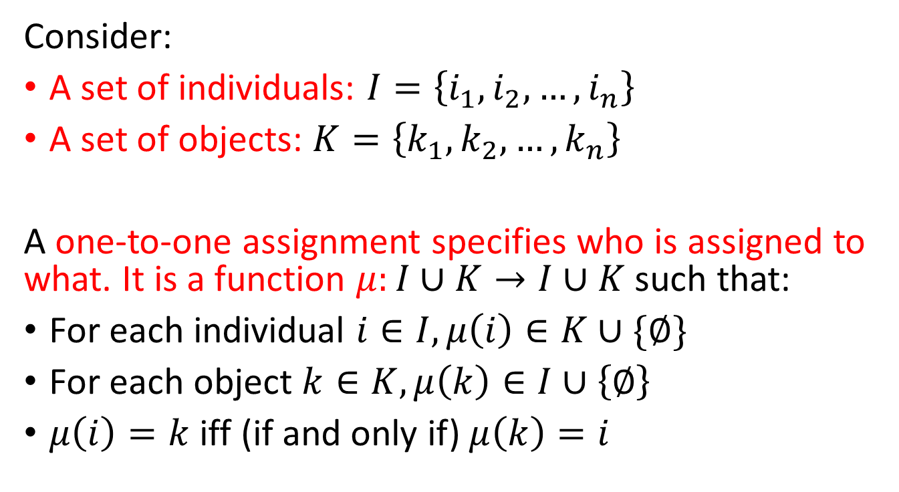
Assignment
Consider:
A set of individuals: $I=\left\{i_{1},i_{2},…,i_{n}\right\}$
A set of objects: $K=\left\{k_{1},k_{2},…,k_{n}\right\}$
A one-to-one assignment specifies who is assigned to what. It is a function $μ:I∪K→I∪K$ such that:
For each individual $i∈I, μ\left(i\right)∈K∪\{∅\}$
For each object $k∈K, μ\left(k\right)∈I∪\left\{∅\right\}$
$μ\left(i\right)=k$ iff (if and only if) $μ\left(k\right)=i$

Slide 4
Endowments
We need to consider the case that some objects may belong to someone at the outset. Thus, there are two types of assignment problems:
None of the objects belong to anyone:
  The is called the public endowment problem. All the objects belong to the whole society
Individuals own the objects:
  This case is called the private endowment problem
It could also be mixed: Private-public endowments:
  Some objects, but not all, are initially owned by some individuals

Slide 5
Evaluating Assignments
We need to define a way to evaluate assignments
There are two cases that should be considered:
Each object has a priority ordering over agents:
  Identifies who has “rights” over the object. This means, who should be considered first when assigning objects
  Similar to preference orderings we used in matching, but they have no implications over “welfare” because they are not preferences
Objects are free: Objects do not come with an ordering over individuals

Slide 6
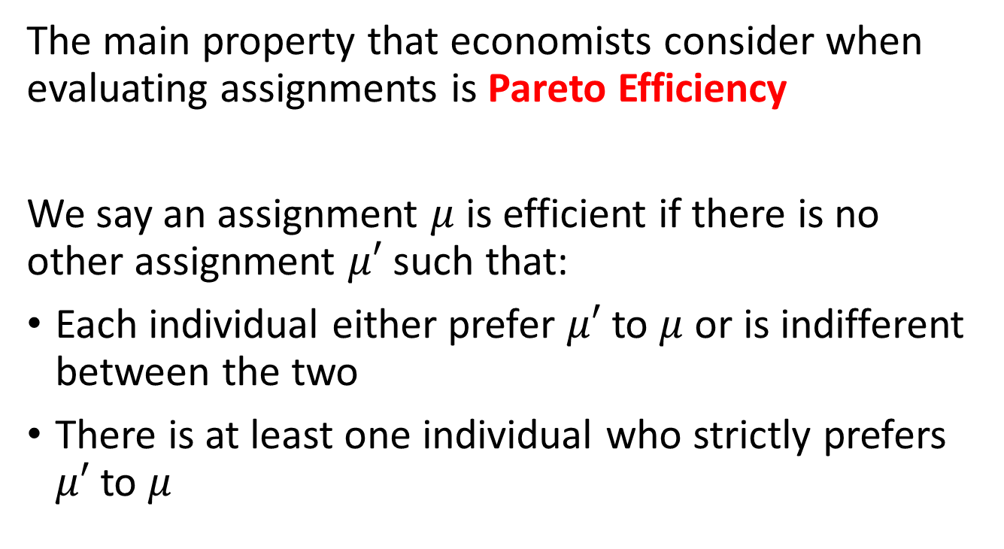
Efficiency
The main property that economists consider when evaluating assignments is Pareto Efficiency
We say an assignment $μ$ is efficient if there is no other assignment $μ′$ such that:
Each individual either prefer $μ′$ to $μ$ or is indifferent between the two
There is at least one individual who strictly prefers $μ′$ to $μ$

Slide 7
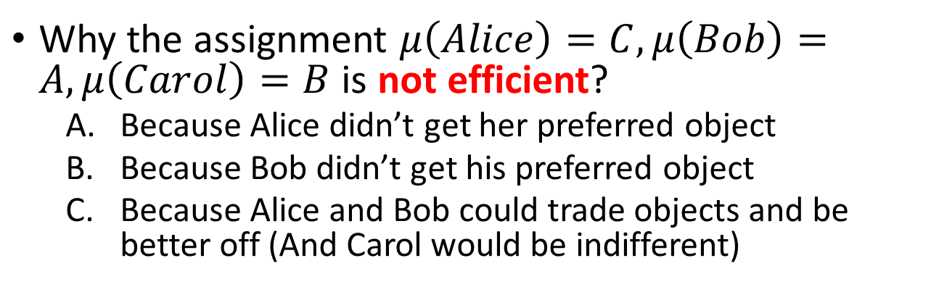
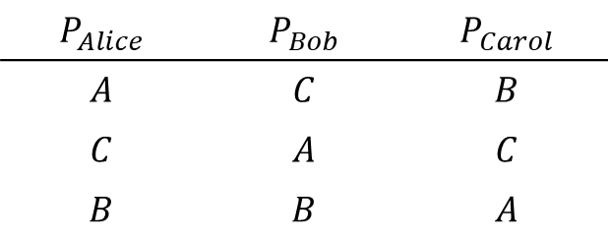
Example
Three individuals: Alice, Bob, and Carol
Three Objects: A, B, and C
$$P_{Alice}$$ | $$P_{Bob}$$ | $$P_{Carol}$$
$$A$$ | $$C$$ | $$B$$
$$C$$ | $$A$$ | $$C$$
$$B$$ | $$B$$ | $$A$$
Why the assignment $μ\left(Alice\right)=C, μ\left(Bob\right)=A,μ\left(Carol\right)=B$ is not efficient?
  Because Alice didn’t get her preferred object
  Because Bob didn’t get his preferred object
  Because Alice and Bob could trade objects and be better off (And Carol would be indifferent)

Slide 8
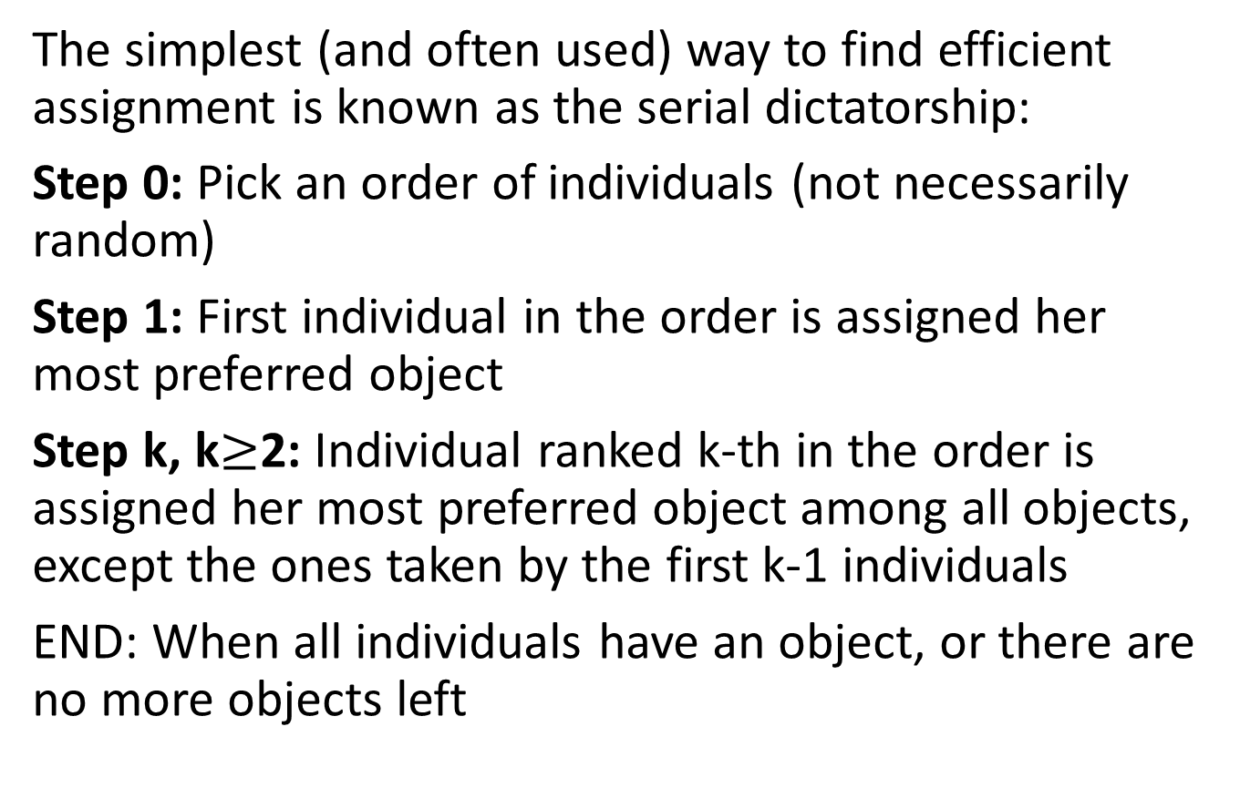
Serial Dictatorship
The simplest (and often used) way to find efficient assignment is known as the serial dictatorship:
Step 0: Pick an order of individuals (not necessarily random)
Step 1: First individual in the order is assigned her most preferred object
Step k, k$≥$2: Individual ranked k-th in the order is assigned her most preferred object among all objects, except the ones taken by the first k-1 individuals
END: When all individuals have an object, or there are no more objects left

Slide 9
Efficiency and Strategyproofness
For any order of individuals:
The assignment obtained with the serial dictatorship is efficient
A preference revelation mechanism using serial dictatorship is strategyproof
Proof:
Take the k-th individual. They took their most preferred object among the remaining ones:
  The only way to make them better off, is taking an object away from someone that chose earlier (not allowed by algorithm)
When is your turn to pick, there is nothing to lose from picking your favorite object

Slide 10
Assignment with Endowments
You can still use the serial dictatorship with endowments
  Dictator can just take the object from anyone
Problem is that someone may end up with an object that is less preferred than their initial endowment
A solution is to allow individuals to trade their endowments
We do this with the Top Trading Cycle (TTC) algorithm
  General principle is to draw a graph where individuals point to the object that they want

Slide 11
Top Trading Cycle
Step 1:
Each individual points to the individual owning the object she prefers the most
There is always at least one cycle: When starting from an agent and following the arrows we eventually reach the agent again
For each agent in a cycle, assign her the object owned by the individual she is pointing to
Remove from the problem all agents (and their objects) who were part of the cycle

Slide 12
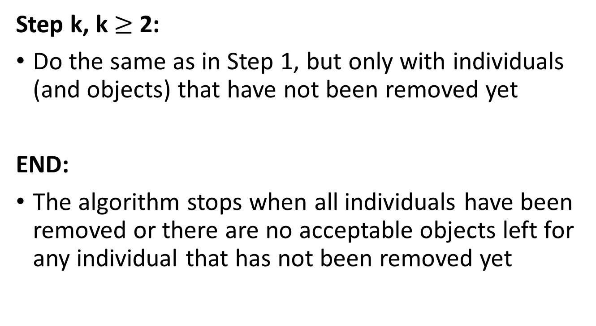
Top Trading Cycle
Step k, k $≥$ 2:
Do the same as in Step 1, but only with individuals (and objects) that have not been removed yet
END:
The algorithm stops when all individuals have been removed or there are no acceptable objects left for any individual that has not been removed yet

Slide 13
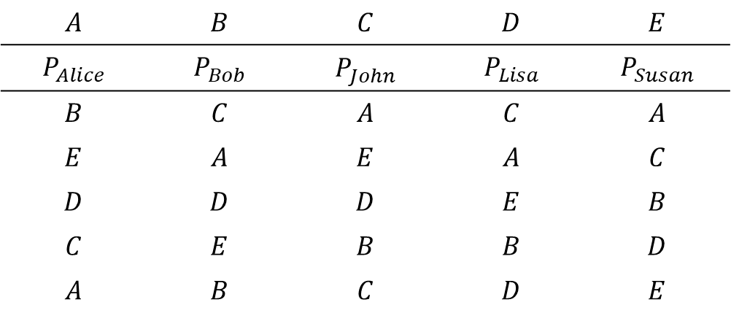
Example
Endowments
$$A$$ | $$B$$ | $$C$$ | $$D$$ | $$E$$
$$P_{Alice}$$ | $$P_{Bob}$$ | $$P_{John}$$ | $$P_{Lisa}$$ | $$P_{Susan}$$
$$B$$ | $$C$$ | $$A$$ | $$C$$ | $$A$$
$$E$$ | $$A$$ | $$E$$ | $$A$$ | $$C$$
$$D$$ | $$D$$ | $$D$$ | $$E$$ | $$B$$
$$C$$ | $$E$$ | $$B$$ | $$B$$ | $$D$$
$$A$$ | $$B$$ | $$C$$ | $$D$$ | $$E$$
Step 1:
B
C
Alice
Bob
John
C
A
Susan
A
Lisa

Slide 14
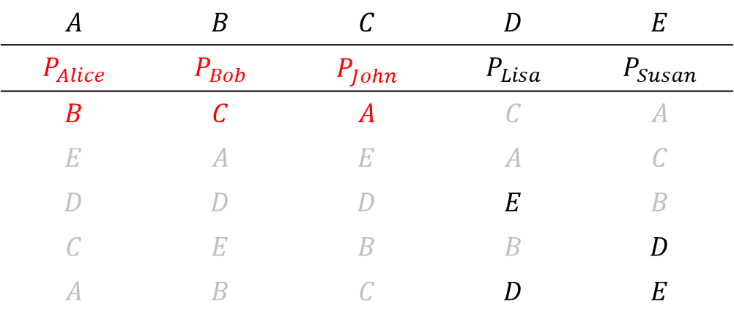
Example
Endowments
$$A$$ | $$B$$ | $$C$$ | $$D$$ | $$E$$
$$P_{Alice}$$ | $$P_{Bob}$$ | $$P_{John}$$ | $$P_{Lisa}$$ | $$P_{Susan}$$
$$B$$ | $$C$$ | $$A$$ | $$C$$ | $$A$$
$$E$$ | $$A$$ | $$E$$ | $$A$$ | $$C$$
$$D$$ | $$D$$ | $$D$$ | $$E$$ | $$B$$
$$C$$ | $$E$$ | $$B$$ | $$B$$ | $$D$$
$$A$$ | $$B$$ | $$C$$ | $$D$$ | $$E$$
Step 2:
D
Susan
Lisa
E

Slide 15
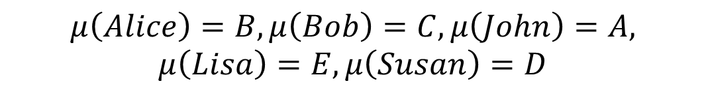
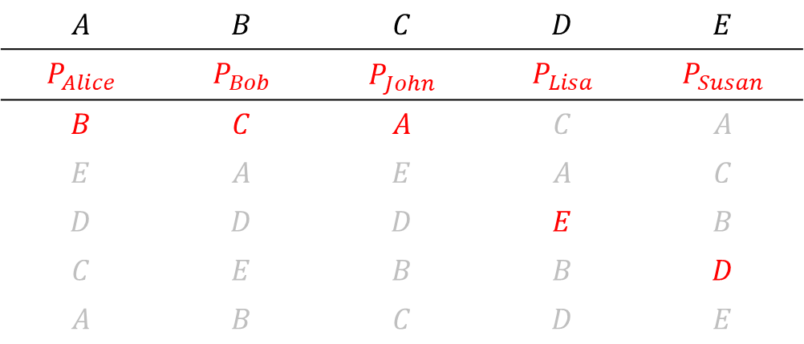
Example
Endowments
$$A$$ | $$B$$ | $$C$$ | $$D$$ | $$E$$
$$P_{Alice}$$ | $$P_{Bob}$$ | $$P_{John}$$ | $$P_{Lisa}$$ | $$P_{Susan}$$
$$B$$ | $$C$$ | $$A$$ | $$C$$ | $$A$$
$$E$$ | $$A$$ | $$E$$ | $$A$$ | $$C$$
$$D$$ | $$D$$ | $$D$$ | $$E$$ | $$B$$
$$C$$ | $$E$$ | $$B$$ | $$B$$ | $$D$$
$$A$$ | $$B$$ | $$C$$ | $$D$$ | $$E$$
$$μ\left(Alice\right)=B, μ\left(Bob\right)=C, μ\left(John\right)=A, μ\left(Lisa\right)=E, μ\left(Susan\right)=D$$

Slide 16
Why TTC works?
It focuses on finding trades to help individuals get their top choice
It allows finding “long chains” of trades that may be difficult to find otherwise (specially when you start adding participants)

Slide 17
Efficiency and Strategyproofness
For any problem:
The assignment obtained with the Top Trading Cycle algorithm is efficient
A preference revelation mechanism using the Top Trading Cycle is strategyproof
WHY?
Individuals assigned in the first cycle get their top choices. For them it is efficient
For the individuals in the second cycle:
  They get their top choice, or
  Their top choice is taken (assigned to some else in first cycle). Only way to make the better off is to make someone (that got assigned in first cycle) worst off

Slide 18
Strategyproofness and Individual Rationality
Both the serial dictatorship and the TTC are group strategyproof:
  No group of agents can jointly misrepresent their preferences in such a way that no agents in the group are worse off and at least someone in the group is better off
The TTC however is the better algorithm because it is individually rational as well
  In serial dictatorship someone could get an object they like less than their initial endowment
Theorem: An assignment mechanism is strategyproof, efficient, and individually rational iff it uses the top trading cycle algorithm

Slide 19
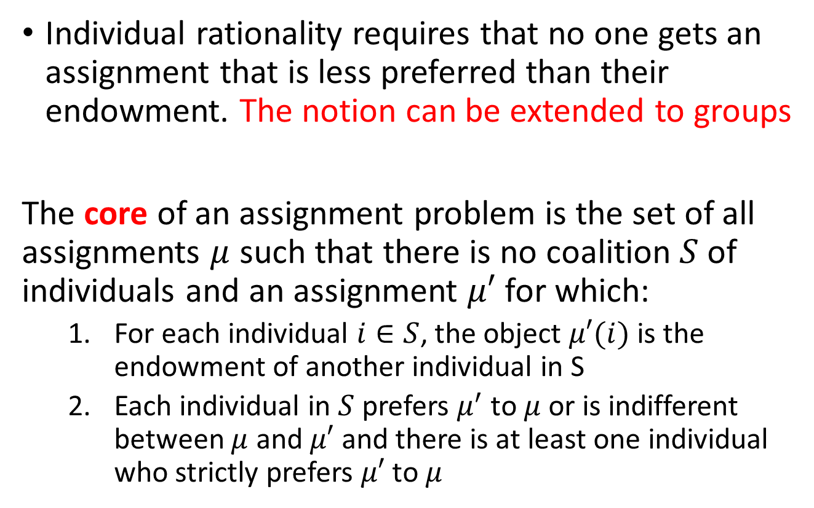
Individual Rationality and The Core
Individual rationality requires that no one gets an assignment that is less preferred than their endowment. The notion can be extended to groups
The core of an assignment problem is the set of all assignments $μ$ such that there is no coalition $S$ of individuals and an assignment $μ′$ for which:
  For each individual $i∈S$, the object $μ′(i)$ is the endowment of another individual in S
  Each individual in $S$ prefers $μ^{′}$ to $μ$ or is indifferent between $μ$ and $μ′$ and there is at least one individual who strictly prefers $μ′$ to $μ$

Slide 20
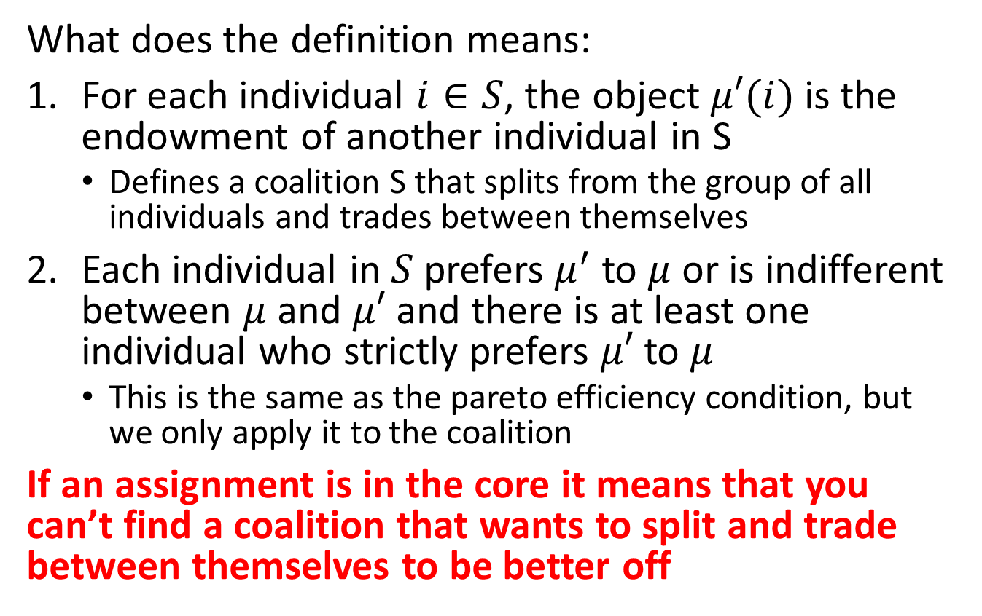
The Core
What does the definition means:
For each individual $i∈S$, the object $μ′(i)$ is the endowment of another individual in S
  Defines a coalition S that splits from the group of all individuals and trades between themselves
Each individual in $S$ prefers $μ^{′}$ to $μ$ or is indifferent between $μ$ and $μ′$ and there is at least one individual who strictly prefers $μ′$ to $μ$
  This is the same as the pareto efficiency condition, but we only apply it to the coalition
If an assignment is in the core it means that you can’t find a coalition that wants to split and trade between themselves to be better off

Slide 21
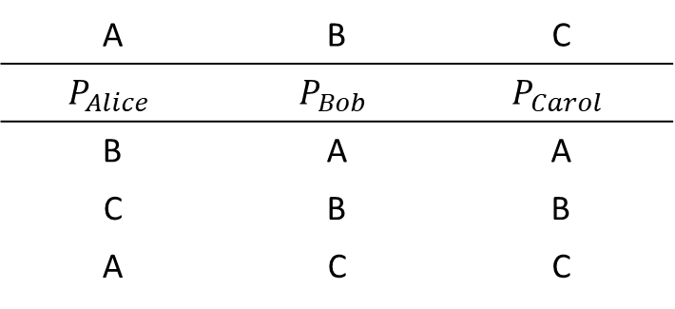
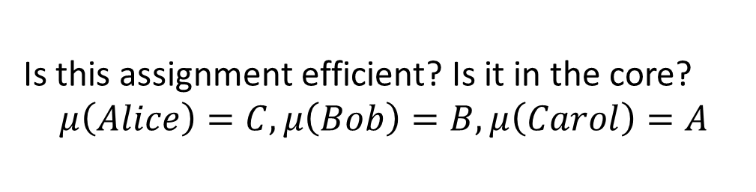
PollEV
Endowment
A | B | C
$$P_{Alice}$$ | $$P_{Bob}$$ | $$P_{Carol}$$
B | A | A
C | B | B
A | C | C
Is this assignment efficient? Is it in the core?
$$μ\left(Alice\right)=C, μ\left(Bob\right)=B, μ\left(Carol\right)=A$$
Answer: The assignment is efficient, but is not in the core. Alice and Bob would be better off by not participating in the assignment and trading their objects between them instead.

Slide 22
How to find assignments in the core
Concept of core is useful, because it provides a good reason to create marketplaces with as many individuals as possible
Will we always have an assignment that is in the core of the assignment problem? Yes
Theorem (Roth and Postlewaite)
For any assignment problem:
There is always a unique assignment that is in the core
The core assignment can be obtained with the top trading cycle algorithm

Slide 23
Objects with Priorities
The TTC can also be used when endowments are public and objects have a priority ordering over individuals
Some changes are necessary:
Each individual points to the object she wants
Each object points to the individual with the highest priority (among individuals who are not assigned any object yet)

Slide 24
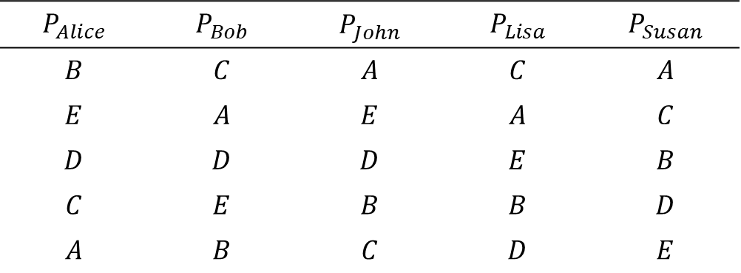
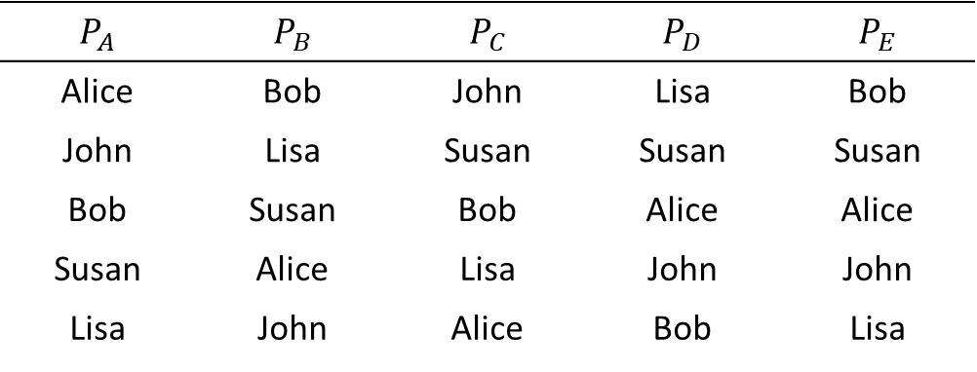
Example
$$P_{Alice}$$ | $$P_{Bob}$$ | $$P_{John}$$ | $$P_{Lisa}$$ | $$P_{Susan}$$
$$B$$ | $$C$$ | $$A$$ | $$C$$ | $$A$$
$$E$$ | $$A$$ | $$E$$ | $$A$$ | $$C$$
$$D$$ | $$D$$ | $$D$$ | $$E$$ | $$B$$
$$C$$ | $$E$$ | $$B$$ | $$B$$ | $$D$$
$$A$$ | $$B$$ | $$C$$ | $$D$$ | $$E$$
$$P_{A}$$ | $$P_{B}$$ | $$P_{C}$$ | $$P_{D}$$ | $$P_{E}$$
Alice | Bob | John | Lisa | Bob
John | Lisa | Susan | Susan | Susan
Bob | Susan | Bob | Alice | Alice
Susan | Alice | Lisa | John | John
Lisa | John | Alice | Bob | Lisa
Notes:
Don on Board!

Slide 25
Example – Step 1
E
Bob
Lisa
Step 1 Cycle:
Bob gets C
John gets A
Alice gets B
B
C
D
Alice
John
A
Susan

Slide 26
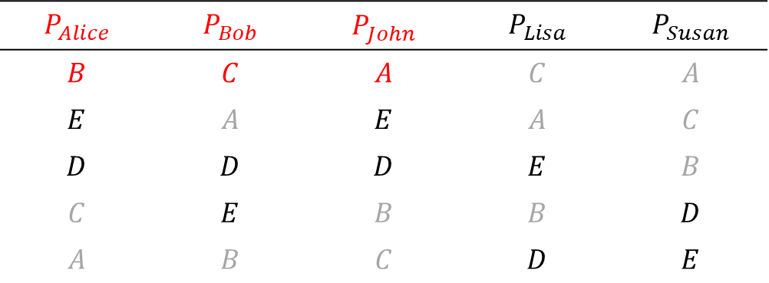
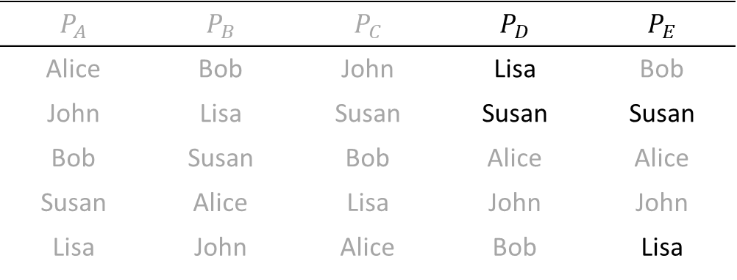
Example
$$P_{Alice}$$ | $$P_{Bob}$$ | $$P_{John}$$ | $$P_{Lisa}$$ | $$P_{Susan}$$
$$B$$ | $$C$$ | $$A$$ | $$C$$ | $$A$$
$$E$$ | $$A$$ | $$E$$ | $$A$$ | $$C$$
$$D$$ | $$D$$ | $$D$$ | $$E$$ | $$B$$
$$C$$ | $$E$$ | $$B$$ | $$B$$ | $$D$$
$$A$$ | $$B$$ | $$C$$ | $$D$$ | $$E$$
$$P_{A}$$ | $$P_{B}$$ | $$P_{C}$$ | $$P_{D}$$ | $$P_{E}$$
Alice | Bob | John | Lisa | Bob
John | Lisa | Susan | Susan | Susan
Bob | Susan | Bob | Alice | Alice
Susan | Alice | Lisa | John | John
Lisa | John | Alice | Bob | Lisa
Notes:
Do on board!

Slide 27
Example – Step 2
Lisa
E
Step 2 Cycle:
Lisa gets E
Susan gets D
D
Susan

Slide 28
Mixed public-private endowments
The case of dorms on campus is a classic example of assignment with public and private endowments:
Private endowment: The students who are already on campus the previous academic year
  The room they occupied the previous year is their private endowment
Public endowments: The rooms that are left vacant by the students who just graduated
Newly arrived students do not have any endowments

Slide 29
Housing Allocation Model
We will review what different universities do (or did in 1998 when the study was done)
There is a set of individuals and a set of houses
Individuals are split into two groups:
  Existing tenants: An individual who already “owns” a house (a student living on campus the previous year and hasn’t graduated yet)
    Their houses are private endowments
  New applicants: Individual who does not has any house (a freshman)

Slide 30
Carnegie Mellon, Duke, Harvard
They use a Random Serial Dictatorship with Squatting Rights:
Step 1: Existing tenants announce whether they want to keep their house. If the do, they are assigned their house. If not, their house is added to the pool of vacant houses
Step 2: We draw a random ordering of individuals consisting of the new applications and the existing tenants who chose not to keep their house
Step 3: Run the serial dictatorship with the order chosen in step 2

Slide 31
Random Serial Dictatorship with Squatting Rights
TL/DR: In period 1 those that already have a room decide to participate or not. If they don’t participate, they keep their room. If they do, their room is added to the pool of available rooms and they get a new room according to the algorithm.

Slide 32
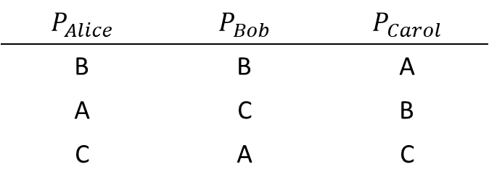
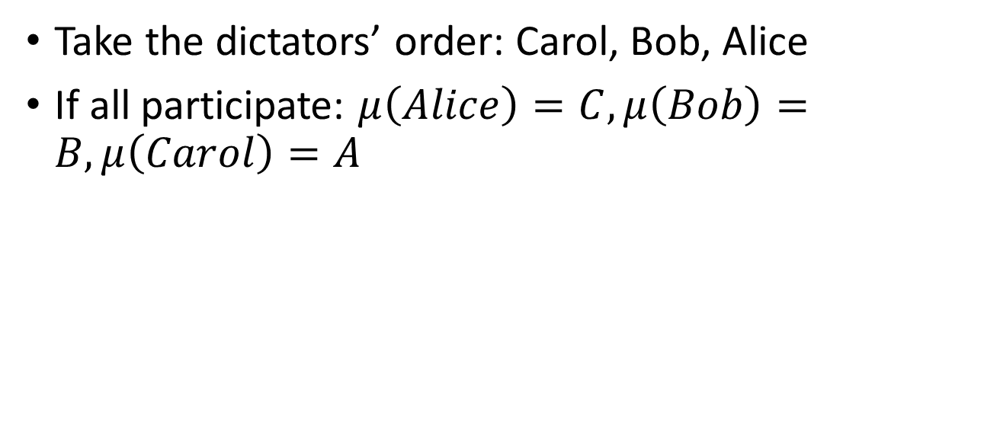
Example
Initial endowment:
Alice owns A
$$P_{Alice}$$ | $$P_{Bob}$$ | $$P_{Carol}$$
B | B | A
A | C | B
C | A | C
Take the dictators’ order: Carol, Bob, Alice
If all participate: $μ\left(Alice\right)=C, μ\left(Bob\right)=B, μ\left(Carol\right)=A$

Slide 33
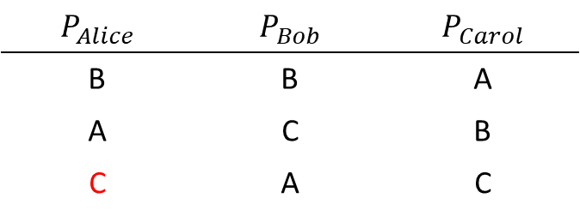
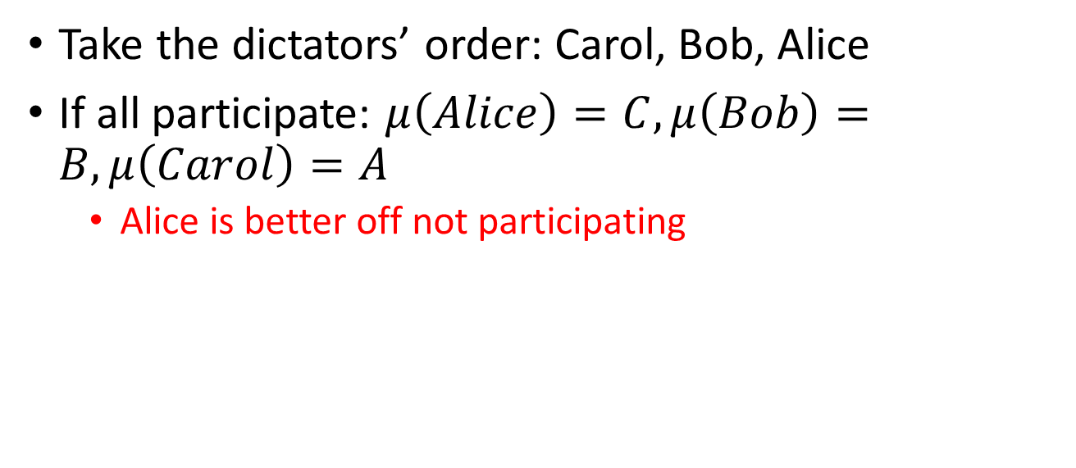
Example
Initial endowment:
Alice owns A
$$P_{Alice}$$ | $$P_{Bob}$$ | $$P_{Carol}$$
B | B | A
A | C | B
C | A | C
Take the dictators’ order: Carol, Bob, Alice
If all participate: $μ\left(Alice\right)=C, μ\left(Bob\right)=B, μ\left(Carol\right)=A$
  Alice is better off not participating

Slide 34
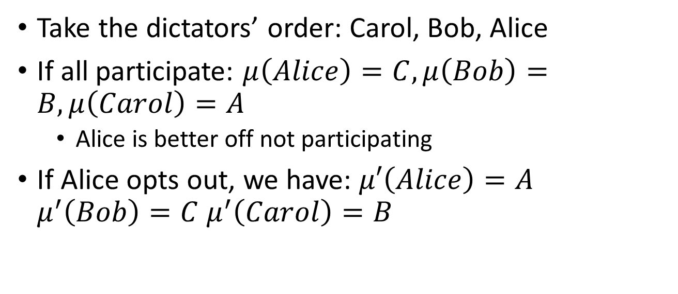
Example
Initial endowment:
Alice owns A
$$P_{Alice}$$ | $$P_{Bob}$$ | $$P_{Carol}$$
B | B | A
A | C | B
C | A | C
Take the dictators’ order: Carol, Bob, Alice
If all participate: $μ\left(Alice\right)=C, μ\left(Bob\right)=B, μ\left(Carol\right)=A$
  Alice is better off not participating
If Alice opts out, we have: $μ′\left(Alice\right)=A$ $μ^{′}\left(Bob\right)=C$ $μ^{′}\left(Carol\right)=B$

Slide 35
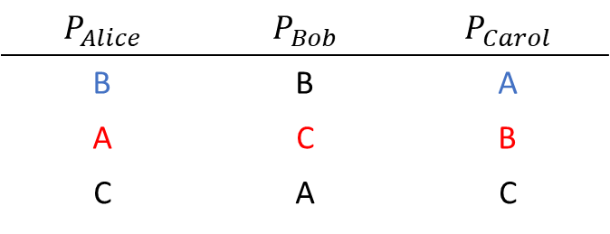
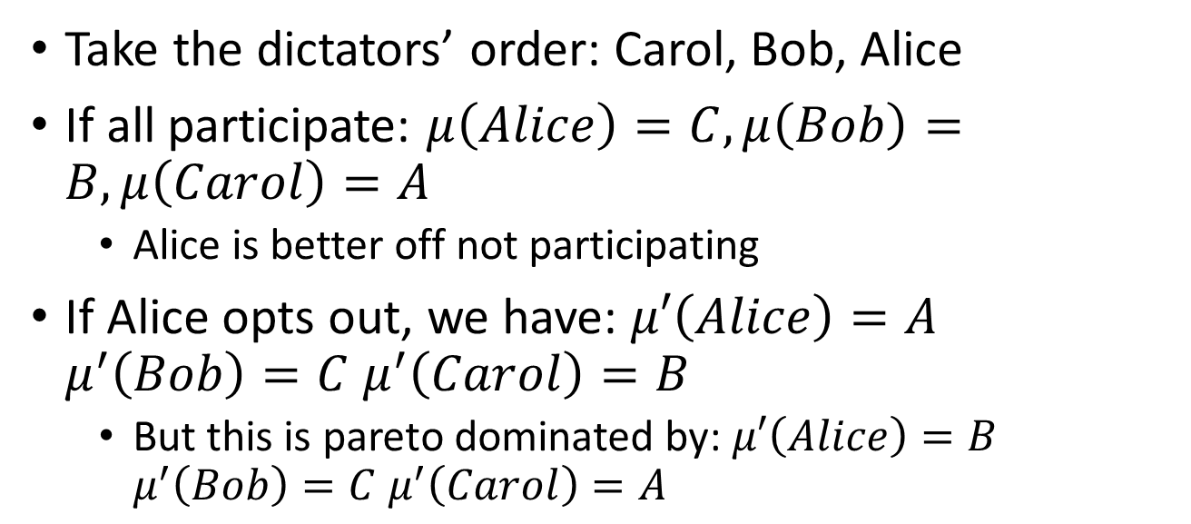
Example
Initial endowment:
Alice owns A
$$P_{Alice}$$ | $$P_{Bob}$$ | $$P_{Carol}$$
B | B | A
A | C | B
C | A | C
Take the dictators’ order: Carol, Bob, Alice
If all participate: $μ\left(Alice\right)=C, μ\left(Bob\right)=B, μ\left(Carol\right)=A$
  Alice is better off not participating
If Alice opts out, we have: $μ′\left(Alice\right)=A$ $μ^{′}\left(Bob\right)=C$ $μ^{′}\left(Carol\right)=B$
  But this is pareto dominated by: $μ′\left(Alice\right)=B$ $μ^{′}\left(Bob\right)=C$ $μ^{′}\left(Carol\right)=A$
This algorithm does not guarantee individual rational assignments. Risk averse tenants may prefer to opt out, resulting in inefficient assignments

Slide 36
Rochester
A fix to prevent existing tenants being worse off is the Random Serial Dictatorship with Waiting Lists
At any step, an individual can only take a house that is available. This happens when:
  The house is part of the public endowment
  The house is left vacant by the existing tenant
An obtainable house is:
  Any house for new applicants
  The endowment or a preferred house for existing tenants

Slide 37
Random Serial Dictatorship with Waiting Lists
TL/DR: You don’t have to give up your room to participate. Once it is your turn to choose, you can either keep your room or choose one of the available rooms. Rooms that are vacated by existing tenants (during their turns) are added to the pool

Slide 38
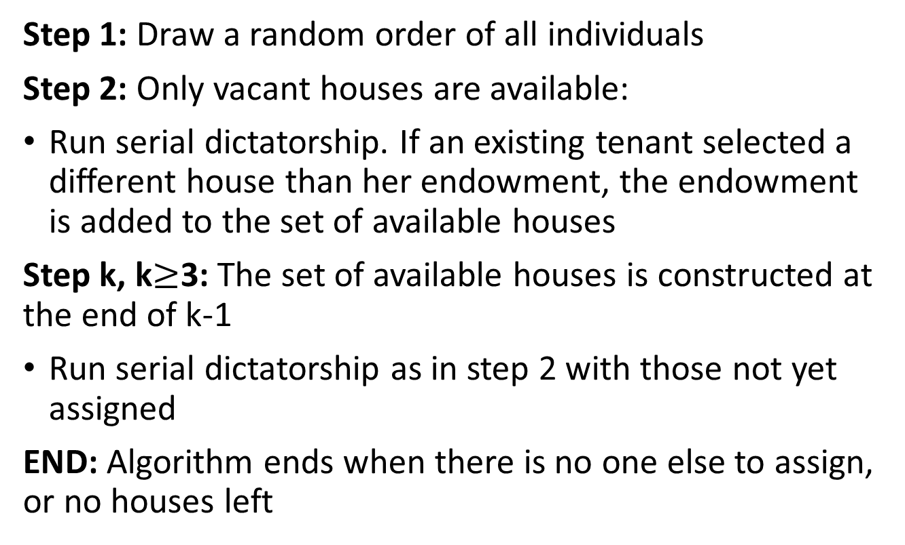
Random Serial Dictatorship with Waiting List
Step 1: Draw a random order of all individuals
Step 2: Only vacant houses are available:
Run serial dictatorship. If an existing tenant selected a different house than her endowment, the endowment is added to the set of available houses
Step k, k$≥$3: The set of available houses is constructed at the end of k-1
Run serial dictatorship as in step 2 with those not yet assigned
END: Algorithm ends when there is no one else to assign, or no houses left

Slide 39
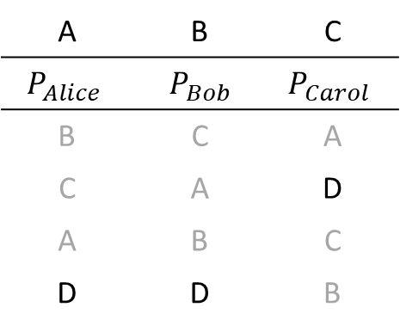
Example:
Endowment
A | B | C
$$P_{Alice}$$ | $P_{Bob}$ | $$P_{Carol}$$
B | C | A
C | A | D
A | B | C
D | D | B
Public Endowment: D
Available Houses: D
Step 1: Order of dictators: Carol, Alice, Bob
Step 2: Carol takes D

Slide 40
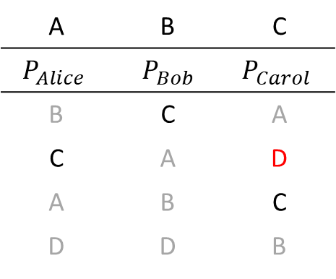
Example:
Endowment
A | B | C
$$P_{Alice}$$ | $P_{Bob}$ | $$P_{Carol}$$
B | C | A
C | A | D
A | B | C
D | D | B
Public Endowment: D
Available Houses: C
Step 1: Order of dictators: Carol, Alice, Bob
Step 2: Carol takes D
(D now removed from available houses; C added)
Step 3: Alice takes C

Slide 41
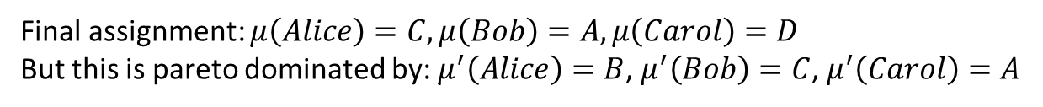
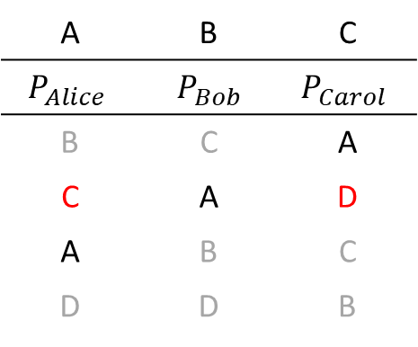
Example:
Endowment
A | B | C
$$P_{Alice}$$ | $P_{Bob}$ | $$P_{Carol}$$
B | C | A
C | A | D
A | B | C
D | D | B
Public Endowment: D
Available Houses: A
Step 1: Order of dictators: Carol, Alice, Bob
Step 2: Carol takes D
(D now removed from available houses; C added)
Step 3: Alice takes C
(C now removed from available houses; A added)
Step 4: Bob takes A
Final assignment: $μ\left(Alice\right)=C, μ\left(Bob\right)=A, μ\left(Carol\right)=D$
But this is pareto dominated by: $μ^{′}\left(Alice\right)=B$, $μ^{′}\left(Bob\right)=C$, $μ^{′}\left(Carol\right)=A$
We gained individual rationality, but this algorithm still does not guarantee efficiency

Slide 42
MIT-NH4
Step 1: Draw a random order of all individuals
Step 2: Assign tentatively houses using serial dictatorship until a squatting conflicts appears
It is the turn to choose of an existing tenants. His house was already requested by someone else (a conflicting individual), and all remaining houses are worse for the tenant
The conflicting individual is the one who picked the tenant’s house
Step 3: If there is a squatting conflict:
Existing tenant is assigned the house
All assignments starting from the conflicting individual are cancelled
Resume serial dictatorship from the conflicting individual
END: No house or individual left. Tentative assignments are finalized

Slide 43
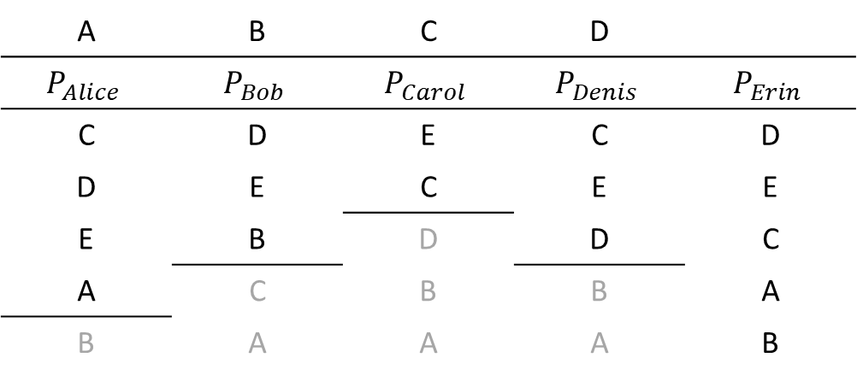
Example
Endowment
A | B | C | D
$$P_{Alice}$$ | $$P_{Bob}$$ | $$P_{Carol}$$ | $$P_{Denis}$$ | $$P_{Erin}$$
C | D | E | C | D
D | E | C | E | E
E | B | D | D | C
A | C | B | B | A
B | A | A | A | B
Order of dictators: Alice, Bob, Carol, Denis, and Erin
Alice chooses C

Slide 44
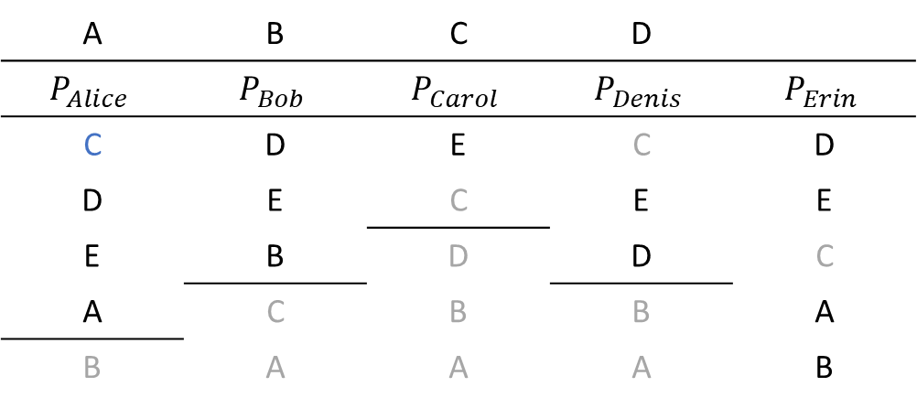
Example
Endowment
A | B | C | D
$$P_{Alice}$$ | $$P_{Bob}$$ | $$P_{Carol}$$ | $$P_{Denis}$$ | $$P_{Erin}$$
C | D | E | C | D
D | E | C | E | E
E | B | D | D | C
A | C | B | B | A
B | A | A | A | B
Order of dictators: Alice, Bob, Carol, Denis, and Erin
Alice chooses C
Bob chooses D

Slide 45
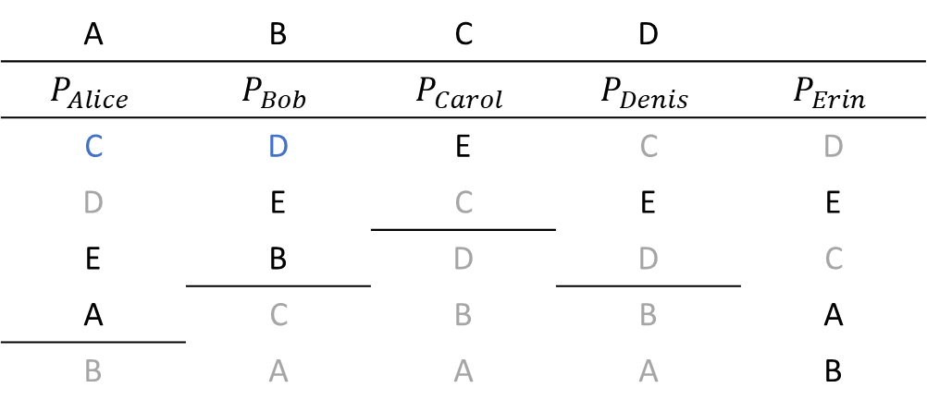
Example
Endowment
A | B | C | D
$$P_{Alice}$$ | $$P_{Bob}$$ | $$P_{Carol}$$ | $$P_{Denis}$$ | $$P_{Erin}$$
C | D | E | C | D
D | E | C | E | E
E | B | D | D | C
A | C | B | B | A
B | A | A | A | B
Order of dictators: Alice, Bob, Carol, Denis, and Erin
Alice chooses C
Bob chooses D
Carol chooses E

Slide 46
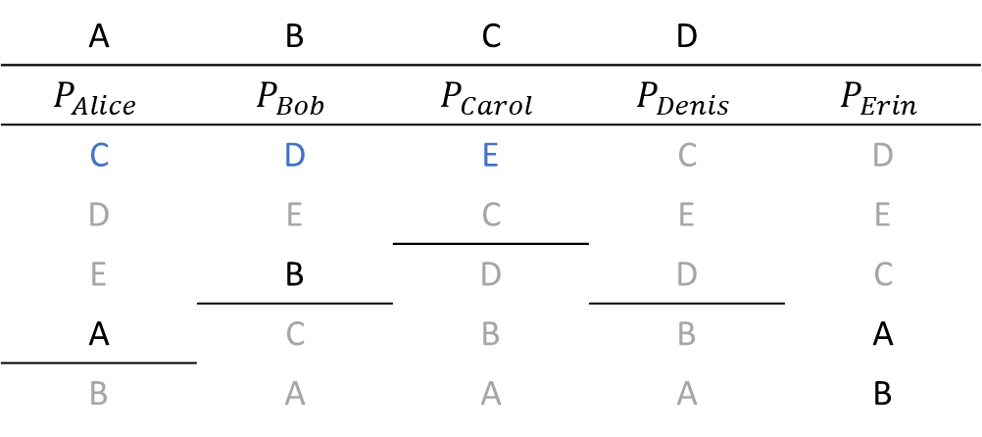
Example
Endowment
A | B | C | D
$$P_{Alice}$$ | $$P_{Bob}$$ | $$P_{Carol}$$ | $$P_{Denis}$$ | $$P_{Erin}$$
C | D | E | C | D
D | E | C | E | E
E | B | D | D | C
A | C | B | B | A
B | A | A | A | B
Order of dictators: Alice, Bob, Carol, Denis, and Erin
Alice chooses C
Bob chooses D
Carol chooses E
Denis: Conflict! C, E, and D are taken. Conflicting individual Bob (took Denis’s endowment, and Denis doesn’t have a better choice
  Bob and Carol’s assignment are cancelled, and Denis is assigned his house D

Slide 47
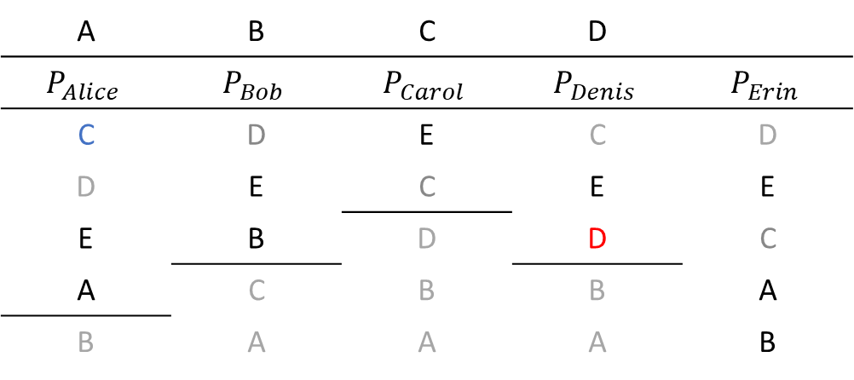
Example
Endowment
A | B | C | D
$$P_{Alice}$$ | $$P_{Bob}$$ | $$P_{Carol}$$ | $$P_{Denis}$$ | $$P_{Erin}$$
C | D | E | C | D
D | E | C | E | E
E | B | D | D | C
A | C | B | B | A
B | A | A | A | B
Order of dictators: Alice, Bob, Carol, Denis, and Erin
Start over from Bob (with Alice and Denis fixed)
Bob chooses E

Slide 48
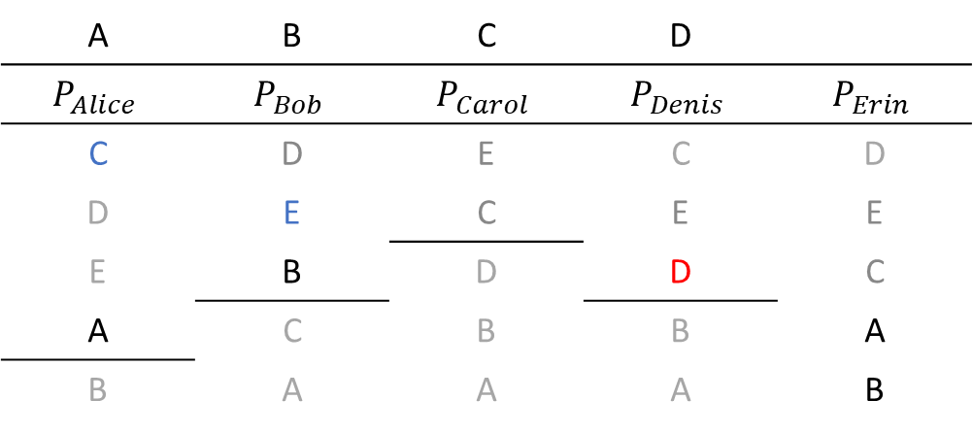
Example
Endowment
A | B | C | D
$$P_{Alice}$$ | $$P_{Bob}$$ | $$P_{Carol}$$ | $$P_{Denis}$$ | $$P_{Erin}$$
C | D | E | C | D
D | E | C | E | E
E | B | D | D | C
A | C | B | B | A
B | A | A | A | B
Order of dictators: Alice, Bob, Carol, Denis, and Erin
Start over from Bob (with Alice and Denis fixed)
Bob chooses E
Carol: Conflict! E and C (the only acceptable for her) are taken
  Conflicting individual Alice, who took Carol’s endowment C
  We remove Alice and Bob from the assignment, and assign Carol to her house C

Slide 49
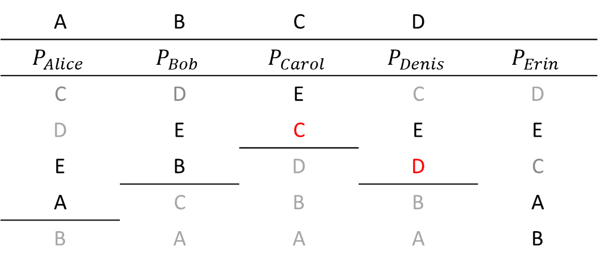
Example
Endowment
A | B | C | D
$$P_{Alice}$$ | $$P_{Bob}$$ | $$P_{Carol}$$ | $$P_{Denis}$$ | $$P_{Erin}$$
C | D | E | C | D
D | E | C | E | E
E | B | D | D | C
A | C | B | B | A
B | A | A | A | B
Order of dictators: Alice, Bob, Carol, Denis, and Erin
Start over from Alice (with Denis and Carol fixed))
Alice chooses E

Slide 50
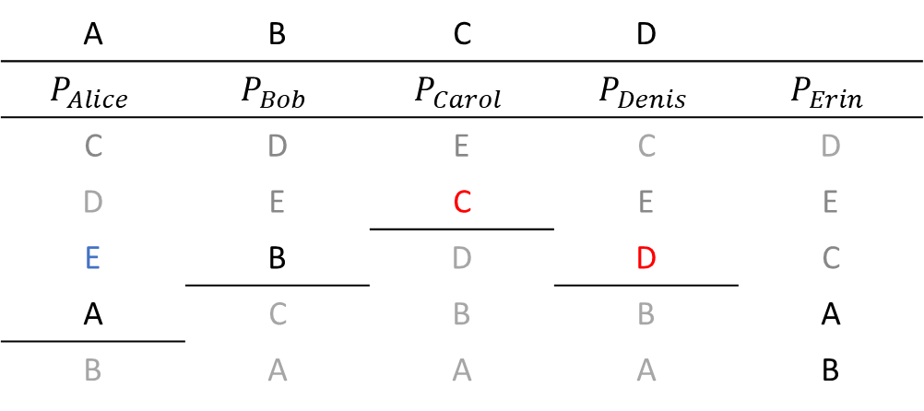
Example
Endowment
A | B | C | D
$$P_{Alice}$$ | $$P_{Bob}$$ | $$P_{Carol}$$ | $$P_{Denis}$$ | $$P_{Erin}$$
C | D | E | C | D
D | E | C | E | E
E | B | D | D | C
A | C | B | B | A
B | A | A | A | B
Order of dictators: Alice, Bob, Carol, Denis, and Erin
Start over from Alice (with Denis and Carol fixed))
Alice chooses E
Bob chooses B

Slide 51
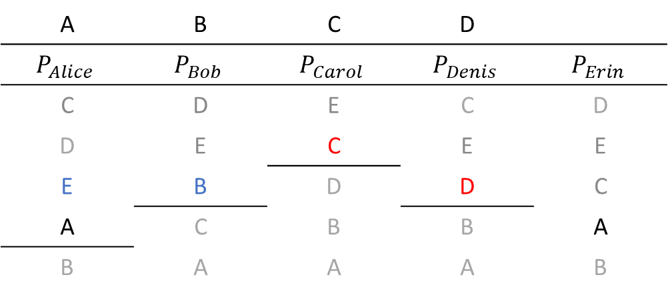
Example
Endowment
A | B | C | D
$$P_{Alice}$$ | $$P_{Bob}$$ | $$P_{Carol}$$ | $$P_{Denis}$$ | $$P_{Erin}$$
C | D | E | C | D
D | E | C | E | E
E | B | D | D | C
A | C | B | B | A
B | A | A | A | B
Order of dictators: Alice, Bob, Carol, Denis, and Erin
Start over from Alice (with Denis and Carol fixed))
Alice chooses E
Bob chooses B
Erin chooses A

Slide 52
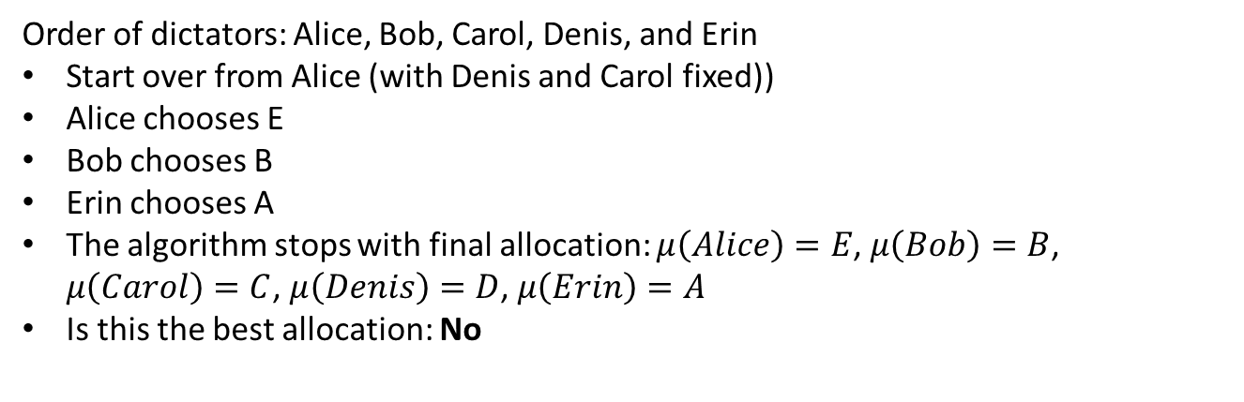
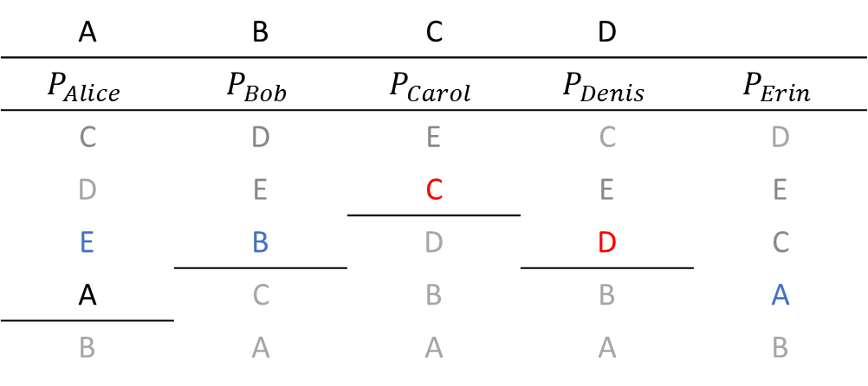
Example
Endowment
A | B | C | D
$$P_{Alice}$$ | $$P_{Bob}$$ | $$P_{Carol}$$ | $$P_{Denis}$$ | $$P_{Erin}$$
C | D | E | C | D
D | E | C | E | E
E | B | D | D | C
A | C | B | B | A
B | A | A | A | B
Order of dictators: Alice, Bob, Carol, Denis, and Erin
Start over from Alice (with Denis and Carol fixed))
Alice chooses E
Bob chooses B
Erin chooses A
The algorithm stops with final allocation: $μ\left(Alice\right)=E$, $μ\left(Bob\right)=B$, $μ\left(Carol\right)=C$, $μ\left(Denis\right)=D$, $μ\left(Erin\right)=A$
Is this the best allocation: No

Slide 53
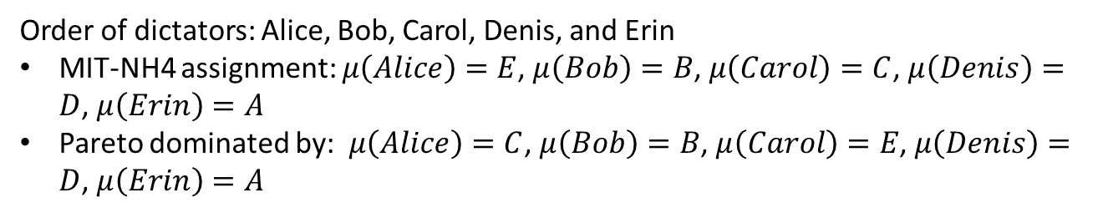
Example
Endowment
A | B | C | D
$$P_{Alice}$$ | $$P_{Bob}$$ | $$P_{Carol}$$ | $$P_{Denis}$$ | $$P_{Erin}$$
C | D | E | C | D
D | E | C | E | E
E | B | D | D | C
A | C | B | B | A
B | A | A | A | B
Order of dictators: Alice, Bob, Carol, Denis, and Erin
MIT-NH4 assignment: $μ\left(Alice\right)=E$, $μ\left(Bob\right)=B$, $μ\left(Carol\right)=C$, $μ\left(Denis\right)=D$, $μ\left(Erin\right)=A$
Pareto dominated by: $μ\left(Alice\right)=C$, $μ\left(Bob\right)=B$, $μ\left(Carol\right)=E$, $μ\left(Denis\right)=D$, $μ\left(Erin\right)=A$

Slide 54
How do you get efficiency then?
The MIT-NH4, Rochester, or CMU/Duke/Harvard mechanisms show that finding an efficient and individually rational assignments is hard
There is a way. Use either:
  An improved version of the MIT-NH4 algorithm
  The top trading cycle algorithm
Moreover, these two alternatives have the advantage of being strategyproof

Slide 55
The problem with MIT-NH4
Key aspect is to define how conflicts are defined and solved:
MIT-NH4: When a conflict happens, all tenant’s acceptable houses are already taken. The attempted fix for conflict was:
  We take away the house from the conflicting individual and give it back to current tenant
  All assignments starting from the conflicting individual are cancelled
  Serial dictatorship resumes from conflicting individual

Slide 56
How do we fix MIT-NH4?
You request my house – I get your turn: The conflict happens as soon as someone requests the house of an existing tenant. To fix conflict:
  All assignments starting from conflicting individual are cancelled
  Re-arrange the order of dictators. The existing tenant is moved just above conflicting individual
  Resume the serial dictatorship starting from existing tenant

Slide 57
You request my house – I get your turn (YRMH-IGYT)
Step 1: Draw a random order of all individuals
Step 2: Assign tentatively houses using serial dictatorship until squatting conflict happens (note that now this happens as soon as a tenant’s house is requested)
Step 3: If there is a squatting conflict:
All assignments starting from the conflicting individual are cancelled
Existing tenant is moved in the order of dictators just above the conflicting individual
Resume serial dictatorship with existing tenant
Step 4: If there is a cycle, assign houses (like in TTC) and remove individual and houses in the cycle from problem
END: Stop when no houses or individuals left

Slide 58
Example
Endowment
A | B | C | D
$$P_{Alice}$$ | $$P_{Bob}$$ | $$P_{Carol}$$ | $$P_{Denis}$$ | $$P_{Erin}$$
C | D | E | C | D
D | E | C | E | E
E | B | D | D | C
A | C | B | B | A
B | A | A | A | B
Order of dictators: Alice, Bob, Carol, Denis, and Erin
Alice chooses C, but existing tenant Carol has not chosen a house yet. Thus, we have a conflict
  We re-arrange the order of dictators: Carol, Alice, Bob, Denis, and Erin and resume from Carol
Carol chooses E, then Alice chooses C (note there is no longer a conflict, because Carol got house E already)

Slide 59
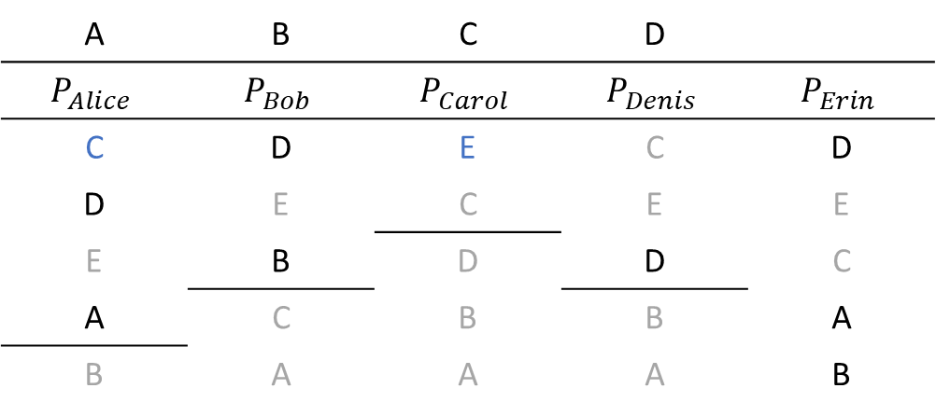
Example
Endowment
A | B | C | D
$$P_{Alice}$$ | $$P_{Bob}$$ | $$P_{Carol}$$ | $$P_{Denis}$$ | $$P_{Erin}$$
C | D | E | C | D
D | E | C | E | E
E | B | D | D | C
A | C | B | B | A
B | A | A | A | B
Order of dictators: Alice, Bob, Carol, Denis, and Erin
Alice chooses C, but existing tenant Carol has not chosen a house yet. Thus, we have a conflict
  We re-arrange the order of dictators: Carol, Alice, Bob, Denis, and Erin and resume from Carol
Carol chooses E, then Alice chooses C (note there is no longer a conflict, because Carol got house E already)
Bob chooses D, but tenant Denis has not chosen yet. We have a new conflict.

Slide 60
Example
Endowment
A | B | C | D
$$P_{Alice}$$ | $$P_{Bob}$$ | $$P_{Carol}$$ | $$P_{Denis}$$ | $$P_{Erin}$$
C | D | E | C | D
D | E | C | E | E
E | B | D | D | C
A | C | B | B | A
B | A | A | A | B
New order of dictators: Carol, Alice, Denis, Bob, Erin (and we resume from Denis)
Denis chooses D

Slide 61
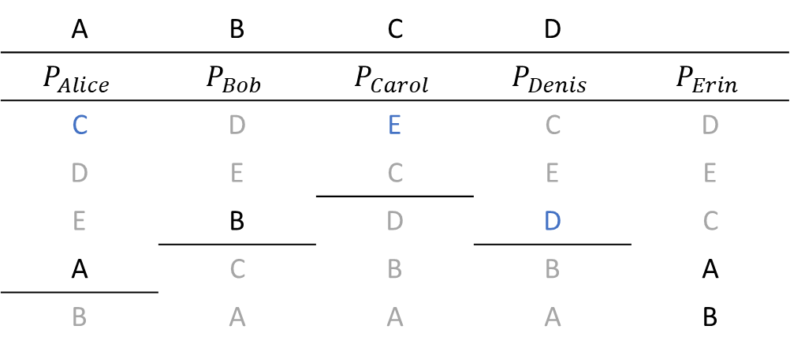
Example
Endowment
A | B | C | D
$$P_{Alice}$$ | $$P_{Bob}$$ | $$P_{Carol}$$ | $$P_{Denis}$$ | $$P_{Erin}$$
C | D | E | C | D
D | E | C | E | E
E | B | D | D | C
A | C | B | B | A
B | A | A | A | B
New order of dictators: Carol, Alice, Denis, Bob, Erin (and we resume from Denis)
Denis chooses D (his house, so he is just is assigned his house)
Bob chooses B (his house, so he is just assigned his house)

Slide 62
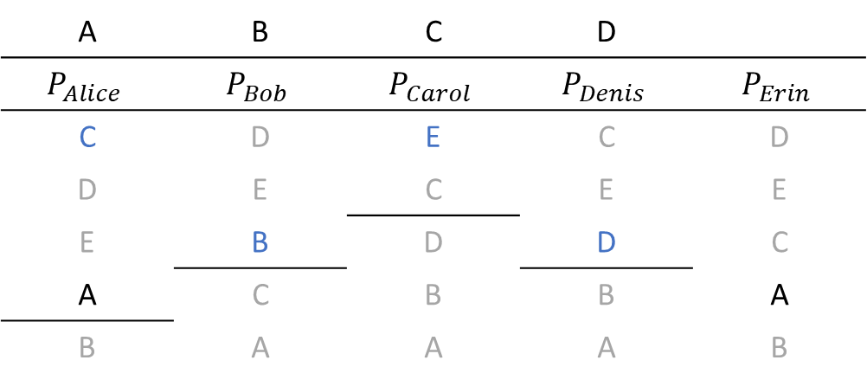
Example
Endowment
A | B | C | D
$$P_{Alice}$$ | $$P_{Bob}$$ | $$P_{Carol}$$ | $$P_{Denis}$$ | $$P_{Erin}$$
C | D | E | C | D
D | E | C | E | E
E | B | D | D | C
A | C | B | B | A
B | A | A | A | B
New order of dictators: Carol, Alice, Denis, Bob, Erin (and we resume from Denis)
Denis chooses D (his house, so he is just is assigned his house)
Bob chooses B (his house, so he is just assigned his house)
Erin chooses A (note no conflict happens, because Alice already chose another house)
The algorithm finishes with allocation:
$μ\left(Alice\right)=C$, $μ\left(Bob\right)=B$, $μ\left(Carol\right)=E$, $μ\left(Denis\right)=D$, $μ\left(Erin\right)=A$

Slide 63
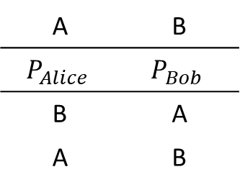
YRMH-IGYT: Potential Problem
When changing the order of dictators, endless loops may happen
Endowment
A | B
$$P_{Alice}$$ | $$P_{Bob}$$
B | A
A | B
Order is: Alice, Bob
Alice chooses B, so we change the order to Bob, Alice
Bob chooses A, so we change the order to Alice, Bob
Endless loop
In this case, the YRMH-IGYT algorithm says that in this case we do as in TTC:
Alice takes B
Bob takes A

Slide 64
TTC with Mixed Endowments
This algorithm works like TTC when the objects have a priority:
Individuals point to the house they want
Houses point to an individual. BUT HOW?
  Occupied house point to their tenants
  Draw a random order of the individuals
    This order will become the priority ordering over individuals of all vacant houses
Run the TTC
Exercise: Repeat the assignment we did using YRMH-IGYT using TTC w/ mixed endowments assuming that the order of dictators is: Alice, Bob, Carol, Denis, and Erin

Slide 65
Results
Theorem:
An assignment mechanism that uses the TTC algorithm with mixed endowment is (for any random ordering):
Efficient
Individually rational
Strategyproof
Theorem:
For any ordering of the individuals, the YRMH-IGYT algorithm yields the same outcome as the TTC algorithm with mixed endowments (using the same ordering of individuals)

Slide 66
Take Away
We discussed multiple algorithms for assignment problems in different settings (endowments, priorities over objects)
Serial Dictatorship
  Strategyproof, but not necessarily individually rational when individuals have endowments
Top trading cycle (with private endowments and with public endowments and priorities over objects)
  Strategyproof, efficient, and individually rational

Slide 67
Take Away
We introduced two new concepts:
  Group strategyproof: No group of agents can jointly misrepresent their preferences in such a way that no agents in the group are worse off and at least someone in the group is better off
  Core: If an assignment is in the core it means that you can’t find a coalition that wants to split and trade between themselves to be better off
Algorithms for assignment problems with public-private endowments
  CMU/Duke/Harvard: Not individually rational
  Rochester: Not efficient
  MIT-NH4: Not efficient
  YRMH-IGYT/TTC with mixed endowments: Strategyproof, efficient, and individually rational

